Slide 1
301, Nov 5, Class 22
(Some) History of Psychology
Case Study research
Some methods in Developmental Psychology

Slide 2
Brief History of Psychology
Introspection
  1890, William James
  Subjective reflection
Behaviorism
  1930, BF Skinner
  Quantitative measures, animals
Cognitive Revolution
  1960, George Miller 7+2
  Quantitative measures, humans
Moden Methods
  Cognitive Neuroscience, 1990-
  Quantitative measures, neuroscience and physiology, humans

Slide 3
Observation as a Method
Watching the behavior of people around you
  Old-fashioned method for developing ideas
  “Didja ever notice how…?”
Social media studies
Diary studies

Slide 4
Case Study Research Methods
Qualitative descriptions of special cases
  Observational, non-experimental
Generate theory and inspire subsequent experimental research
Illustrate and illuminate differences in human experience
  Oliver Sacks, “The Man Who Mistook His Wife for a Hat”

Slide 5
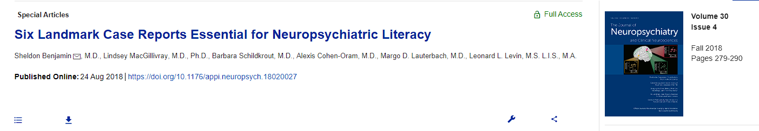
Landmark Case Studies
Phineas Gage
“Tan”
Auguste Deter
“S”
“JP”
“HM”

Slide 6
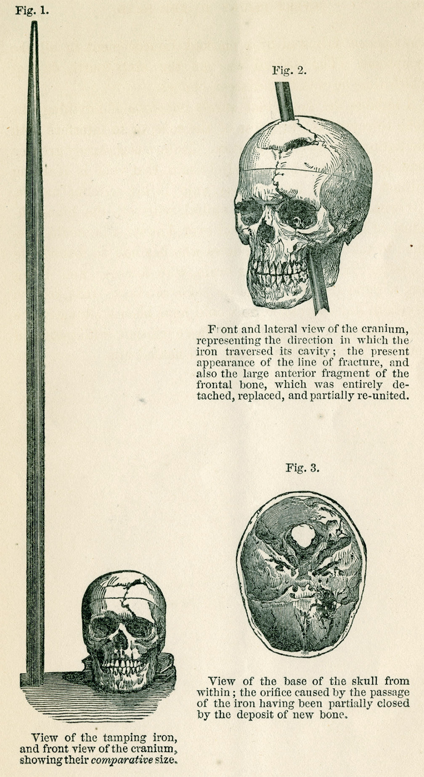
Phineas Gage
1848
Tamping iron accident
  74 days recovery
20 years later
  It was only in a follow-up paper 20 years later that Harlow described Gage’s behavioral changes after recovery. Gage had not been rehired as foreman because he had become disinhibited, with the “animal passions of a strong man,” “impatient of restraint or advice” and, “indulging at times in the grossest profanity (which was not previously his custom).”1 Having formerly been regarded as smart, efficient and capable, Gage’s friends famously stated that after the accident he was “no longer Gage.”

Slide 7
Cognitive Neuroscience
“Tan”
1861 description of an aphasic patient by Broca
Language impairment and post-mortem identification of left anterior frontal lobe damage
  Right side paralysis and language dysfunction already well-known
Localization of language as a cognitive function
  Wernicke
Modularity of cognitive operations

Slide 8
Case Studies
Auguste Deter
  First characterization of Alzheimer’s disease
Solomon Shereshevsky, “S”
  Luria’s subject in “Mind of a Mnemonist”
  Extraordinary memory, personality problems
JP
  Childhood prefrontal cortex damage and severe comportment problems
Henry Molaison, H.M.
  Characterization is the foundation of modern memory systems

Slide 9
Patient EP
Anterograde amnesia similar to HM
  Extensive bilateral medial temporal lobe damage due to encephalitis
  Extremely impaired memory
https://youtu.be/7Grh3PeEMIg?t=187

Slide 10
Case Study Questions
What is a case study in psychological research? How does it differ from other research methods like experiments or surveys?
What types of psychological questions or phenomena are best suited for case study research? Provide an example.
List two advantages and two disadvantages of using case study research in psychology.
Suppose a researcher studies a single child with an extremely rare language disorder over five years. What features make this a case study, and what kind of conclusions can and can’t be drawn from it?
Why might a clinical psychologist choose a case study approach when developing a new form of therapy? What are the trade-offs?

Slide 11
Development
Often similar in spirit to case study research
  Document and describe psychological phenomena at specific ages
Extended by theory of change over time
  Growth, learning
Longitudinal studies
  Following a cohort over an extended period of time
  Lots of within-participants data, takes a long time to complete
Cross-sectional studies
  Compare across ages at a specific time point
  Faster to complete, potentially more generalizable

Slide 12
Developmental Research with Infants
Preferential Looking Technique
  Forced-choice preferential looking
  Violations of expectation
Core Knowledge
  Pre-wired knowledge of the world in infancy
  Sensitivity to language structure
  Awareness of visual objects, physics

Slide 13
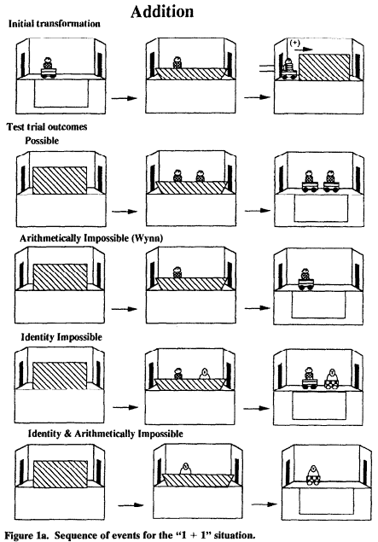
Numeracy example
Infant seated on parent’s lap facing the stage
  20 3-5m old infants (of 36)
Experimenter waited until the infant looked at the display for 5s, then the display was occluded and additional objects introduced, then scene revealed
Two independent coders analyzed video recording of infant gaze

Slide 14
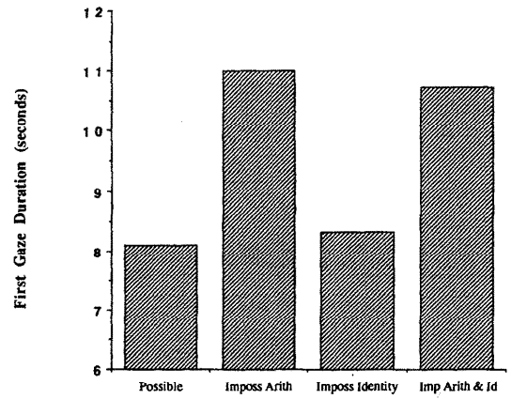
Viewing times
Babies looked longer at numerically impossible outcomes
  1 -> 2 or 2 -> 1
Did not look longer at “identity” violations
  Swapping toys
Appear to understand basic numerosity

Slide 15
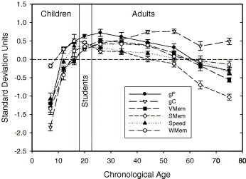
Lifespan development
Development of cognitive change
Growth in children
  Increasing to ~30
Decline in aging
  From 30-35
  General processing speed, working memory, “fluid” decreases
  Knowledge increases

Slide 16
For Friday, 11/7
Chapter 14, Surveys and Instruments
  Questions on Canvas (not in textbook for some reason)
Keep your final project proposal progressing

